Slide 1

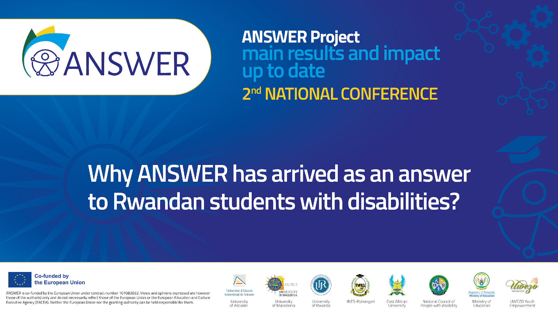
ANSWER PROJECT
FINAL CONFERENCE: READY TO MOVE FORWARD
From Vision to Reality: How ANSWER is Shaping Inclusive Higher Education in Rwanda
Noelia López, Senior Project Manager, University of Alicante

Slide 2


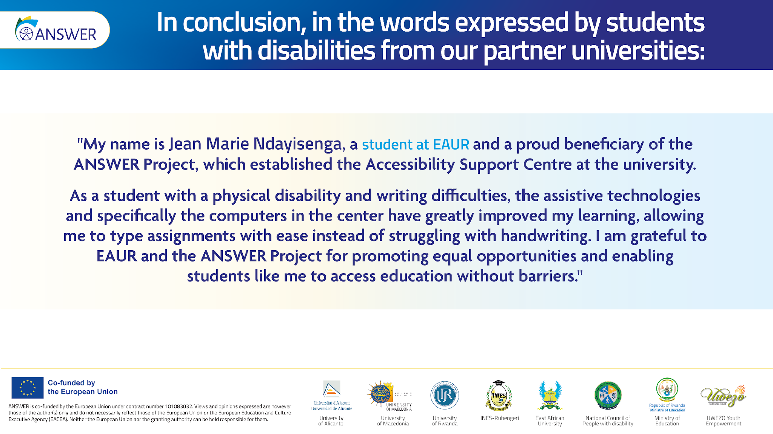

INDEX
0. About us: OGPI
ANSWER CONSORTIUM
Initial Challenge
Results
Human Stories
ANSWER Project Global Impact
National Transformation
ANWER’s legacy in Rwandan Higher Education
Voices of beneficiaries
ERASMUS+ Projects / PDI

Slide 3


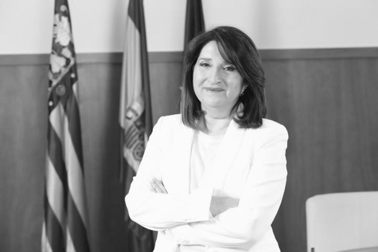
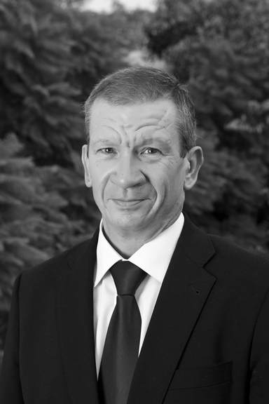



0. ABOUT US: OGPI
Institutional Projects
University Chancellor
Director for Institutional
Relations and Projects
ERASMUS+ Projects (OGPI & Academic staff)
ERASMUS+ Projects / PDI

Slide 4
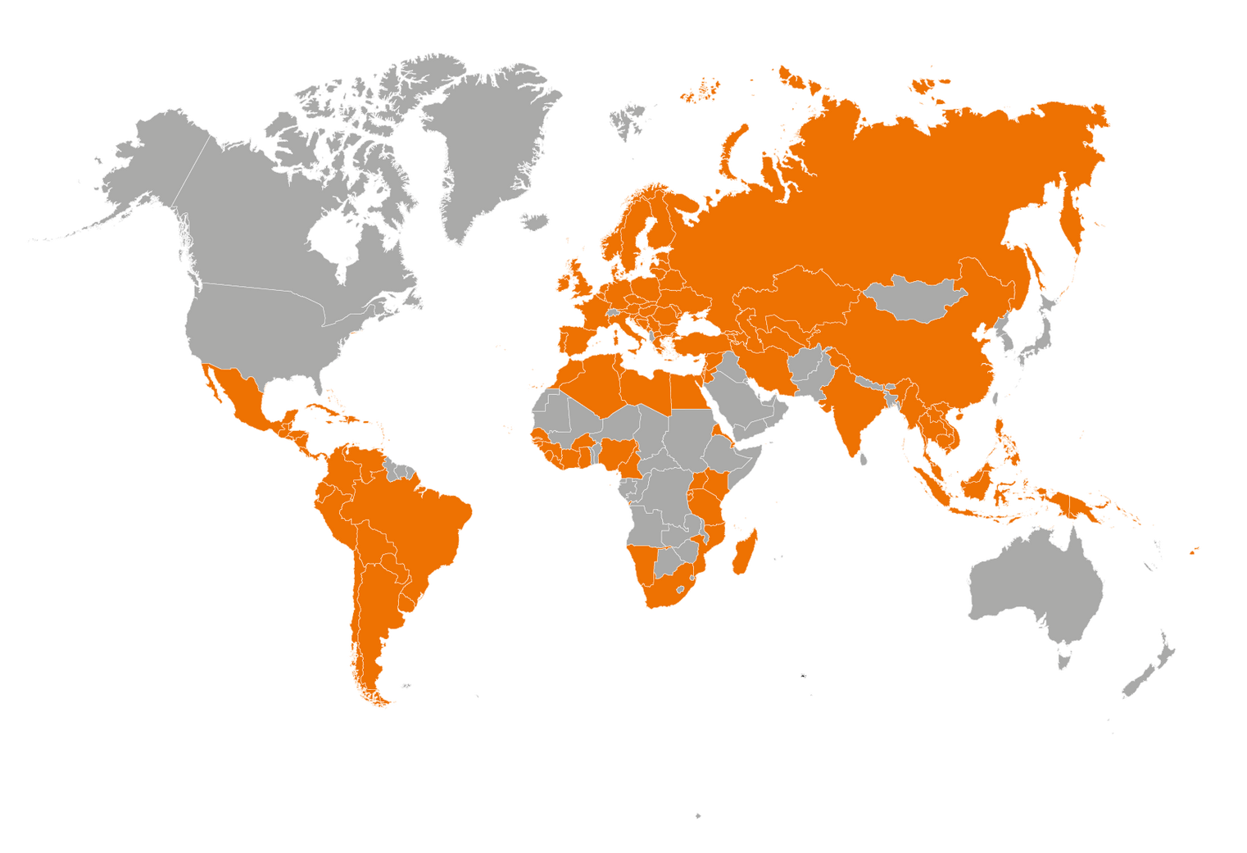
0. ABOUT US: OGPI
23+ years
of experience.
263+ projects
creating opportunities.
124 +countries
a common vision.

Slide 5
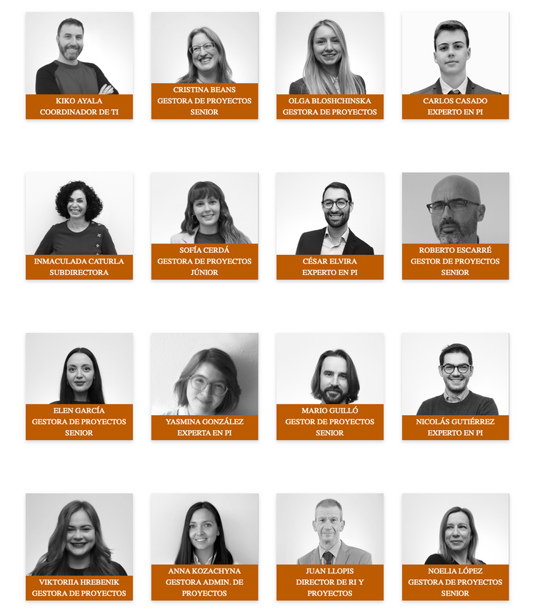
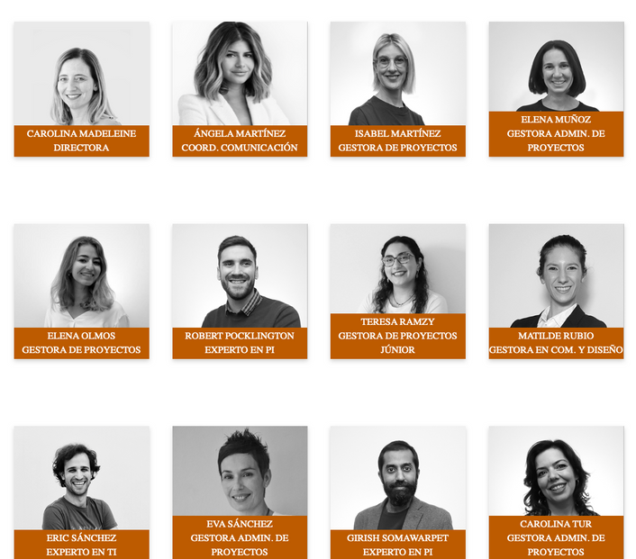
0. ABOUT US: OGPI
At OGPI, people make
the difference.
Director, Deputy Director, IP Experts, Project Managers, Admin and Communication Team.

Slide 6
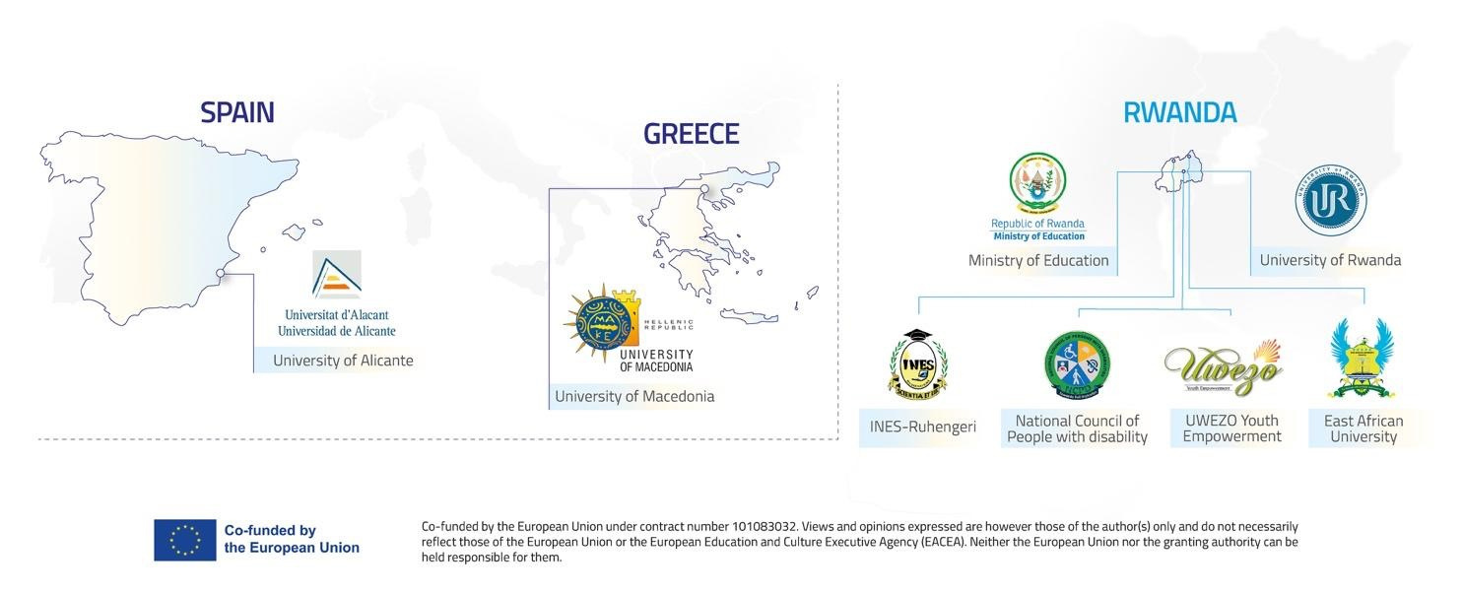
ANSWER CONSORTIUM

Slide 7



2. INITIAL CHALLENGE
Lack of institutional policies on disability or effective implementation
01
01
Institutional inclusion policies adopted or under development
Before
Proposal for a National Strategy for effective implementation & Monitoring Disability Inclusion in HE
Gap between policy design & implementation
02
02
Insufficient assistive technology
03
03
Assistive devices available & actively used
Needs Analysis
Low awareness among staff & students
04
04
Implemented awareness campaigns & training
What barriers did students with disabilities face in Rwanda?
Inexistence/inadequate Support Centres for SWDs
Student Support Centres for SWDs established/ improved
05
05
Weak staff capacity
06
06
Staff trained in inclusive practices
After
Lack of internship programmes with a disability-inclusive approach
07
Establishment of inclusive internship programmes at partner HEIs
07

Slide 8


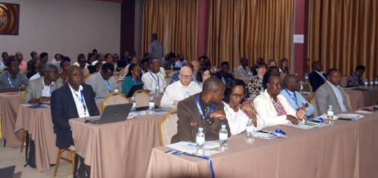
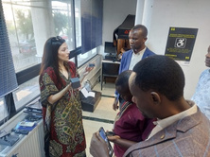

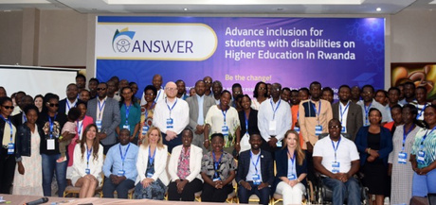
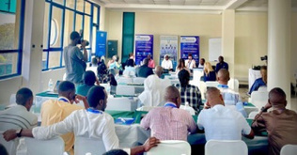


3. RESULTS
PHASE 1. Launch, Needs Analysis, Study Visits & Awareness Raising
Study Visit to the EU: UA & UoM
July, 2023
(+100 participants)
Dissemination Event:
Kick-off Meeting
8 June, 2023
Public Awareness
Kigali, Rwanda
6, 7 January 2023
Kigali, Rwanda
(81 participants)
1st National Conference
July, 2024
NEEDS ANALYSIS
START OF THE PROJECT
1 MARCH 2023

Slide 9


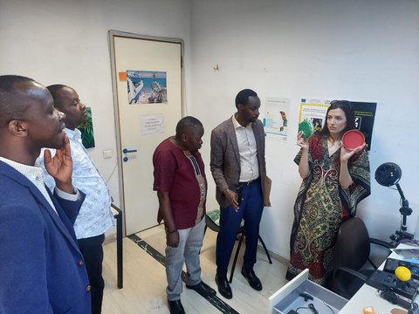
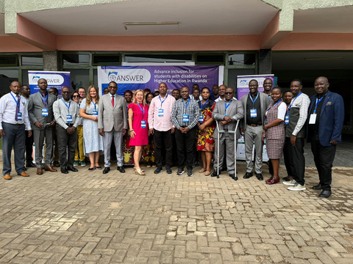
3. RESULTS
PHASE 2. Capacity Building Blended Learning: Online Training + Face-to-face Trainings
558 people trained!!!
(MODULE 2. Equal Access in Academic
and Social Life for All)
199 people trained
Online Training Module 2
1st Training of Trainers
3rd Training of Trainers, EAUR
September 2023
Online Training Module 3
University of Rwanda, Kigali,
Nyagatare, July 2024
(MODULE 3. Transition Support to Post
Graduate Studies and the Labour Market)
180 people trained
2nd Training of Trainers, INES-Ruhengeri,
March 2024
Online Training Module 1
179 people trained
(MODULE 1. Understanding
Disability and Inclusion)

Slide 10

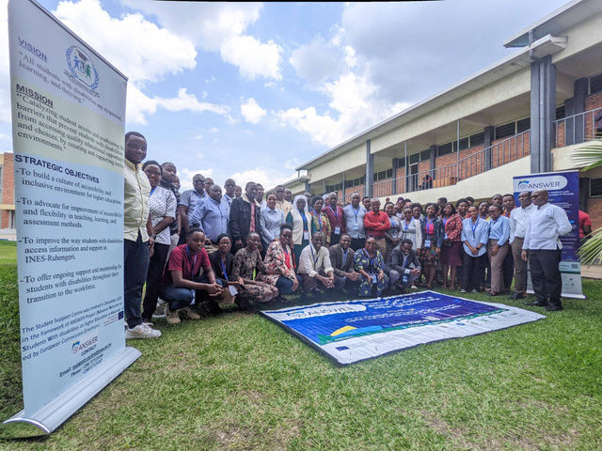
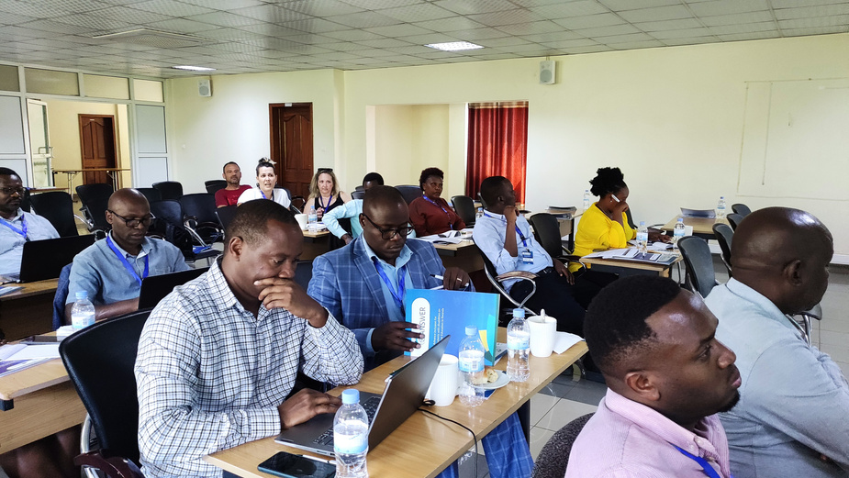

3. RESULTS
PHASE 3. Institutional Phase
Sustainability of the Support Centres
Capacity building of SSC Staff (Train of Trainers)
Development of Institutional Inclusive Policies
Support Centres: Pilot Trainings
(181 participants)
UR: Revision of Policy on Inclusive Learning and Teaching
INES: Updated policies on staff development, research and safety
EAUR: Redesign of Special Needs Policy + new Budget line
Purchase of Assistive Technology Equipment
Creation/modernization of 3 Student Support Centres (SSC) and procurement of equipment
Sustainability Strategy

Slide 11
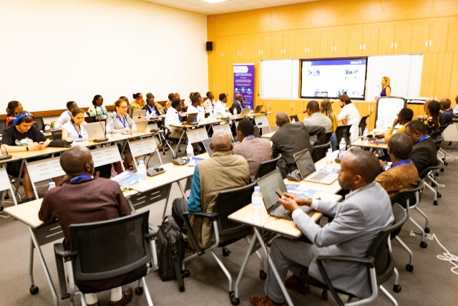
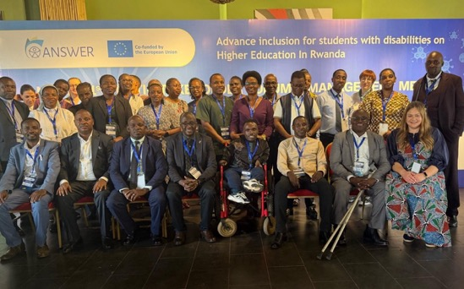
3. RESULTS
Proposal for a National Strategy for Effective Implementation & Monitoring Disability Inclusion in Higher Education
PHASE 4. Internships in companies & Systemic impact
2nd Multi-stakeholder Forum
(Sep 2025)
Partner HEIs: review of existing internship agreements to ensure they are inclusive
(67 attendees)
Databases registering the numbers of SWDs and types of disabilities at each University
Mapping companies where SWDs can complete internships
1st Multistakeholder Forum
(March 2025)
(42 attendees)
Systemic Impact: Establishment of ANSWER Multi-Stakeholder Working Group
Partner HEIs starting to reach internship agreements with inclusive approaches
UWEZO Youth Empowerment has signed Collaborationagreements with the 3 partner universities

Slide 12

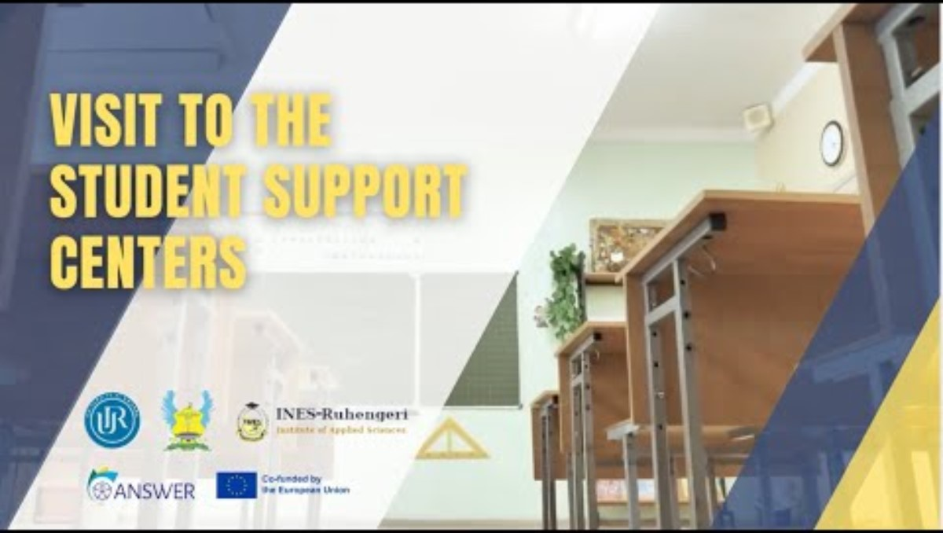
4. Human Stories – Voices of Students with Disabilities

Slide 13

5. ANSWER Project Global Impact – A Visual Overview
195
2226
869
NUMBER OF STUDENTS WITH DISABILITIES BENEFITED
54
TOTAL NUMBER OF PEOPLE IMPACTED
TOTAL NUMBER OF PEOPLE TRAINED
MEMORANDUM OF UNDERSTANDING BETWEEN BUSINESSES AND COMPANIES BEING SIGNED
Intellectual/psychological disabilities
Physical disabilities
Visual impairment
Hearing impairment
Chronic skin conditions

Slide 14

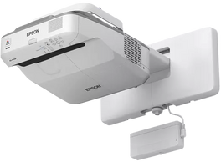
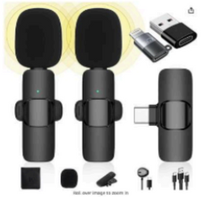
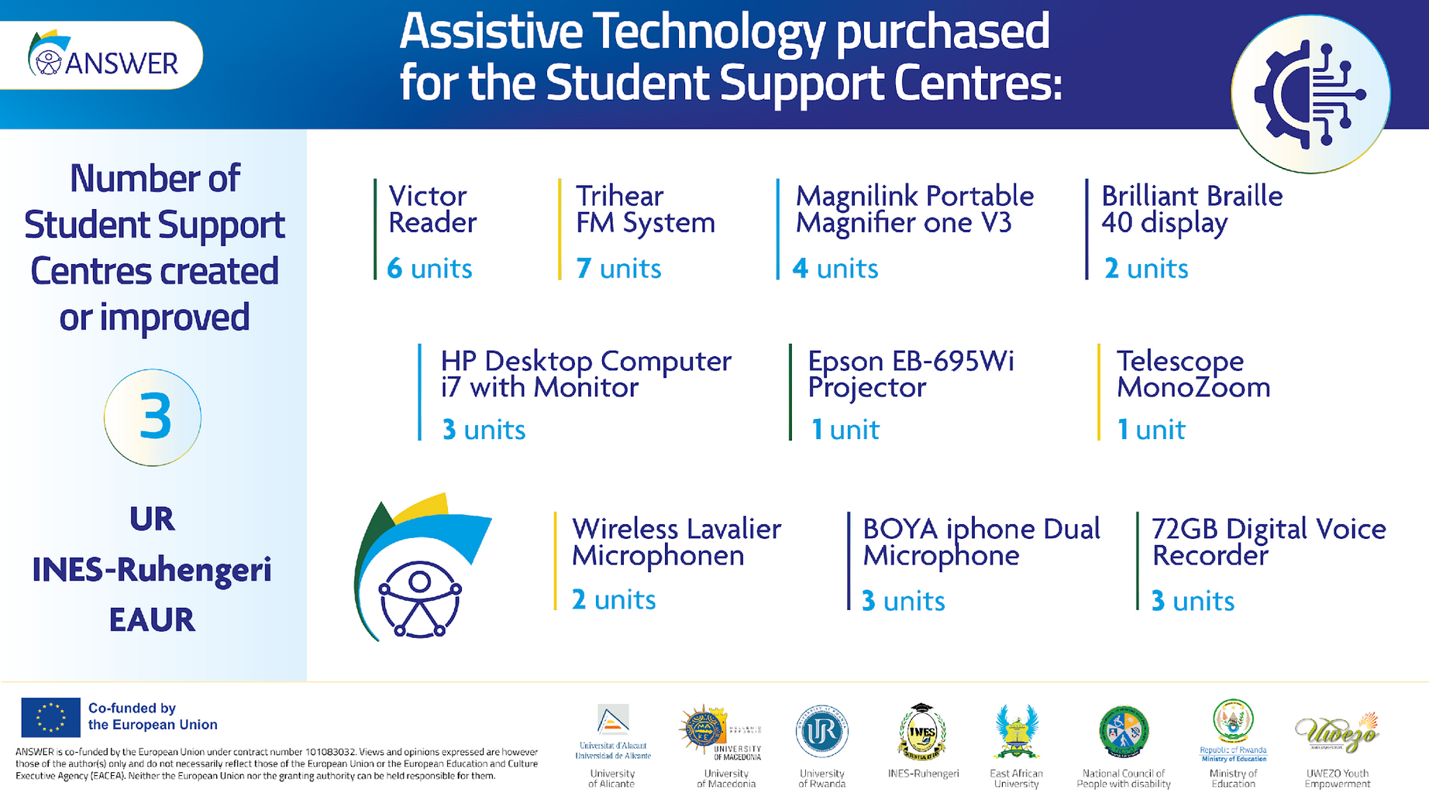
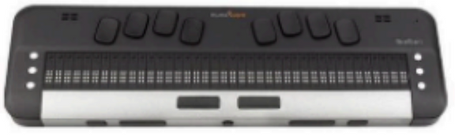
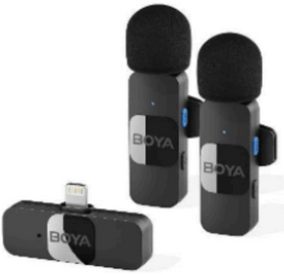


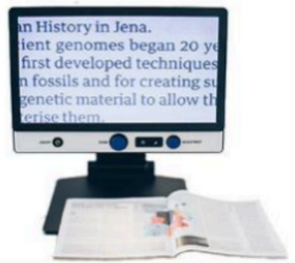
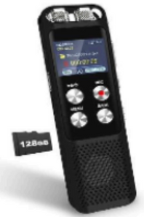





5. ANSWER Project Global Impact – A Visual Overview
Centres established 3

Slide 15

5. ANSWER Project Global Impact – A Visual Overview
1
1
2
3
3
Kick-of Meeting
Dissemination Event
Study Visits to EU Universities: UA (Spain) and UoM (Greece)
National Conferences
Outreach Events
3
3
6
2
3
Training of Trainers
3 Awareness Raising Events at UR, INES-Ruhengeri and EAUR
Pilot Trainings at Rwandan partner universities by Student Support Centres
Multi-Stakeholder Forums
NCPD Field Visits to UR, INES-Ruhengeri and EAUR Campuses

Slide 16
6. National Transformation
How ANSWER is Changing Higher Education in Rwanda
1
3
5
7
9
Awareness: Dissemination Events, Outreach Campaigns, Awareness-raising events, Conferences
Proposal for a National Strategy for Effective Implementation & Monitoring Disability Inclusion in HE
Closing gap between policy & implementation
Institutional Inclusive Policies
Disability inclusive internships programmes
Improvement Support Services for SWDs
Increase in the enrolment of student with disabilities
MoUs Signature for internships
Empowering local stakeholders
2
4
6
8

Slide 17
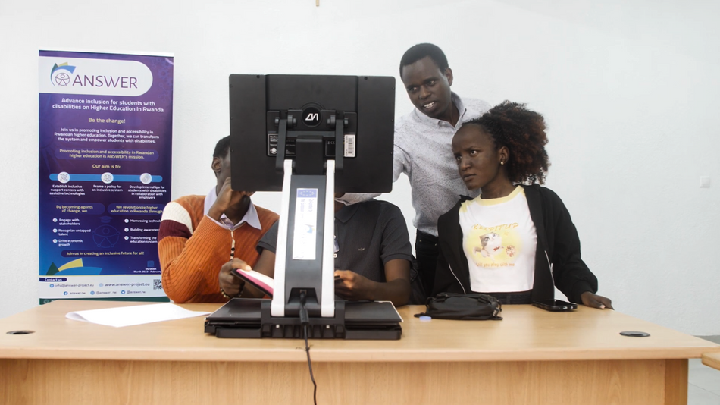
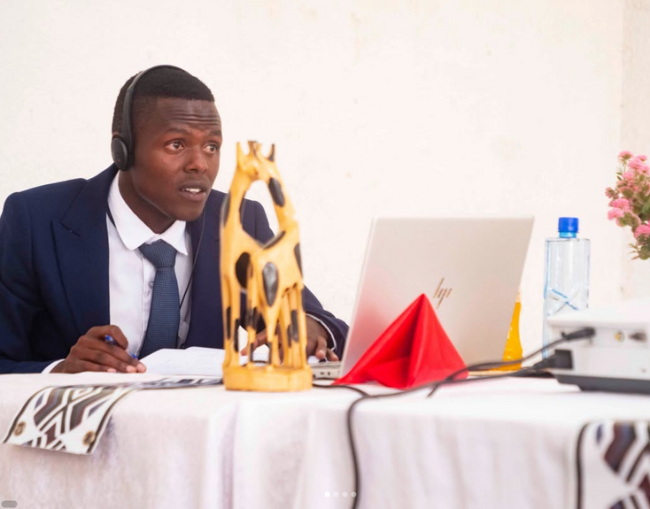
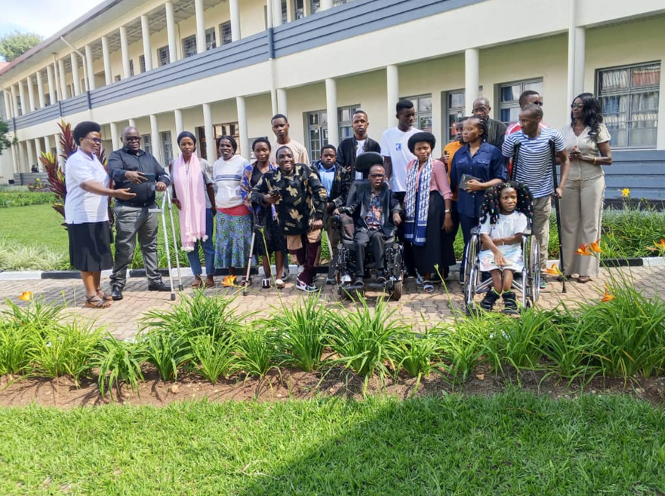


7. ANSWER’s legacy in Rwandan Higher Education
LONG-TERM COMMITMENT TO SUSTAINABILITY:
ONGOING SUPPORT BEYOND THE PROJECT:
Promoting active collaboration and networking among policymakers, educational staff, NGOs, the private sector and other relevant stakeholders
Roadmap for a sustainable practice change in Rwanda.
Continuation of the three Student Support Centres and the services they provide to SWDs after the conclusion of the ANSWER project.

Slide 18



8. Voices of beneficiaries
“As I have a visual impairment, my university is giving me some assistance, for example, in reading.”
“If I had this earlier, my academic life would have been much easier.”
“I am grateful to EAUR and ANSWER for promoting equal opportunities and enabling students like me to Access education without barriers.”
Simon Peter Iragena, Land Survey student at INES-Ruhengeri, could present his final-year dissertation thanks to ANSWER.
Nsegiymva Jean Damascene, UR Student
Jean Marie Ndayisenga, EAUR student

Slide 19
Thank You!
Murakoze!
THANK YOU!

